Slide 1
MY CS50 Final project
Differentiation equation solve Helper for High School students.

Slide 2
This program can help for the students who getting started in differentiation equations in High School.

Slide 3
The purpose of this program is to make familiar IT tools for those students who do Mathematics in High School and make it easier to solve differentiation equation for the beginners.

Slide 4
As a student who did Advanced Level mathematics, I thought it would be nice to have a tool like this to solve differentiation equations under the A/L Mathematics Syllabus.

Slide 5
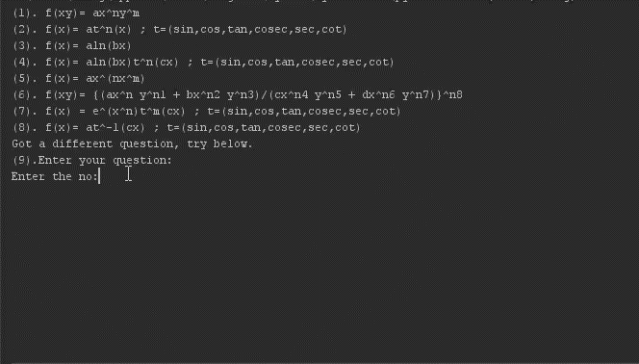

Slide 6
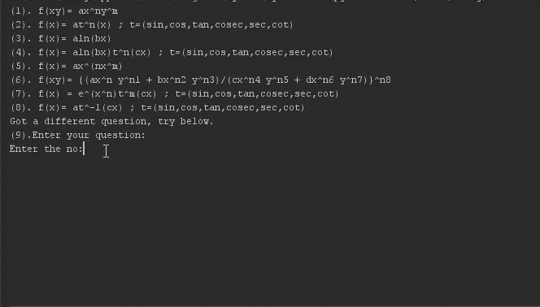

Slide 7
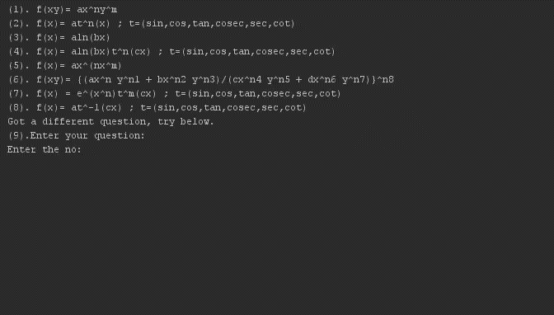

Slide 8
My details.
Name – Viraj Dhananjaya Dissanayake.
Country – Sri Lanka.
City – Badulla.

